Slide 1


Hybrid Crop Recommendation System: Fuzzy Logic + Explainable AI + ML
Transparent, Data-Driven Agronomic Advice
TEAM MEMBERS
FACULTY
R. Anusha (23MIS0362) S.V. Rithul Kanna (23MIS0447) B. Sahaana (23MIS0558) B. Sanjana (23MIS0559)
Dr. Karpagam S

Slide 2












Problem Statement
Who
What
Where
Farmers and agricultural planners lacking transparent, data-driven advice.
Struggle to select optimal crops due to ambiguous environmental variables.
Real-world agricultural environments operating on a continuous spectrum.
When
Why
How (The Flaw)
Critical pre-planting decision phase.
"Black Box" machine learning gives blind recommendations. Farmers can't risk livelihoods on unexplained guesses.
Rigid Boolean logic fails. (e.g., >200mm rainfall needed; 199mm input = 0% match).

Slide 3






Existing Systems & Limitations
Deep Learning & ANN
Decision Trees & Random Forests
Hard-Coded Expert Systems
Highly accurate but a complete "Black Box." Provides zero decision-making insight or reasoning to the end-user.
Extremely rigid manual IF-THEN rules. Impossible to scale effectively and fails entirely when handling ambiguous data.
Suffer from the "Crisp Boundary" problem. Small, negligible input changes can completely flip agricultural recommendations.

Slide 4






Research Objectives
1. Engineer a Soft Computing Engine
2. Implement Explainable AI (XAI)
3. Benchmark via Hybrid Deployment
Replace rigid Boolean thresholds with Fuzzy Logic and Triangular Membership Functions for continuous agricultural data.
Design an architecture outputting a "Defuzzified Match Percentage" and mathematically explaining feature contributions.
Build an interactive web app evaluating the Fuzzy Logic model against 6 standard Machine Learning models in real-time:

Slide 5


Dataset Source & Description
Source: Kaggle's "Crop Recommendation Dataset" (2,200 unique data points).
Target Classes: 22 diverse crops (ranging from water-intensive to dry-weather).
7 Continuous Input Parameters:
Macronutrients: Nitrogen (0-140), Phosphorus (5-145), Potassium (5-205).
Soil Acidity: pH Level (3.5 - 9.9).
Climatic: Temperature (8.8-43.6°C), Humidity (14.2-99.9%), Rainfall (20.2-298.5mm).

Slide 6








System Architecture
1. User Input
2. Fuzzy Engine
3. ML Models
Nitrogen (N)
4. Output & Graphs
Fuzzy Profiling
Random Forest
Phosphorus (P)
Top Recommendation
Mathematical Fuzzification
Decision Tree
Potassium (K)
Explainable AI (XAI)
KNN
Temperature
Inference Evaluation
Feature Contributions
SVM
Humidity
Defuzzification
Model Comparisons
Logistic Regression
pH Level
Suitability Scoring
Interactive UI
Gradient Boosting
Rainfall

Slide 7
Proposed System Modules
Module 1
Dynamic Knowledge Base Profiling Builds 22 "Fuzzy Profiles" from Min/Mean/Max data.
Module 3
Module 5
Fuzzy Inference Engine Cross-evaluates inputs against 22 crops simultaneously.
Interactive Web UI Event-driven frontend triggering the backend engine.
Module 2
Module 4
Mathematical Fuzzification Converts crisp inputs into 0.0-1.0 degree of truth.
Defuzzification & XAI Extraction Translates logic back into a crisp "Suitability Percentage".

Slide 8

Model Output & Explainability
Real-Time Data Processing: Dashboard captures 7 parameters, passing to the Fuzzy Engine in milliseconds.
Fuzzy ML Graphs
🏆 Best Crop
rice
Example Scenario: High moisture (205mm rain, 82% humidity). Engine assigns 0.9 truth to Rice/Jute, 0.0 to Chickpea.
🔍 Explanation
XAI Output: Top Recommendation is Rice (65.16% match). System mathematically explains highly suitable vs. less suitable nutrients.
♦ N is moderately suitable ⚠️ (0.47) for rice.
♦ P is moderately suitable ⚠️ (0.56) for rice.
♦ K is less suitable ❌ (0.39) for rice.
♦ Temperature is highly suitable ✅ (0.90) for rice.
♦ Humidity is highly suitable ✅ (0.87) for rice.

Slide 9
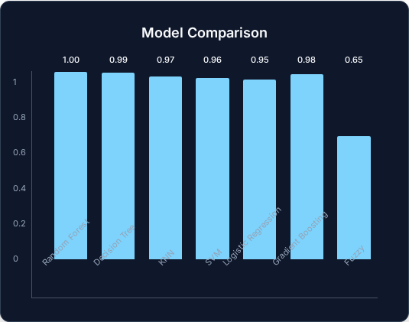
Performance & System Comparison
Feature | Traditional ML | Soft Computing (Ours)
Boundary Handling | Crisp Boundaries | Overlapping Degrees
Model Transparency | Low (Black-box) | High (Explainable)
Failure Mode | Brittle | Graceful Degradation
Computational Load | High | Very Low
Output Utility | Absolute class | Ranked percentage

Slide 10

Conclusion & Impact
Bridging the Gap: Connects raw data to actionable digital recommendations.
Natural Alignment: Triangular Membership Functions natively understand the overlapping, continuous nature of soil and climate conditions.
Uncompromised Accuracy: Proves transparency does not sacrifice accuracy when benchmarked against 6 comparative ML models with XAI integration.
Empowering Farmers: Shifts the paradigm by showing exactly how much a crop matches their land, not just blindly telling them what to plant.
“This system combines the interpretability of fuzzy logic with the predictive power of machine learning.”

